Slide 1
Overview of Optimization Techniques in
Supply Chain Design
Table of content:
1.What is Supply Chain Design?
1.1 Introduction
1.2 Business aspects and Benefits of SCD
1.3 Supply Chain Network Design
1.4 Creating Digital Twin (Role of Data Scientist)
2. Importance of Optimization in Supply Chain Design
3. Types of Optimization Techniques
3.1 complete flow chart
3.2 Deterministic Optimization
3.3 Stochastic Optimization
3.4 Robust Optimization
4. Application Areas in Supply Chain Design
5. Supply Chain KPI Metrics

Slide 2
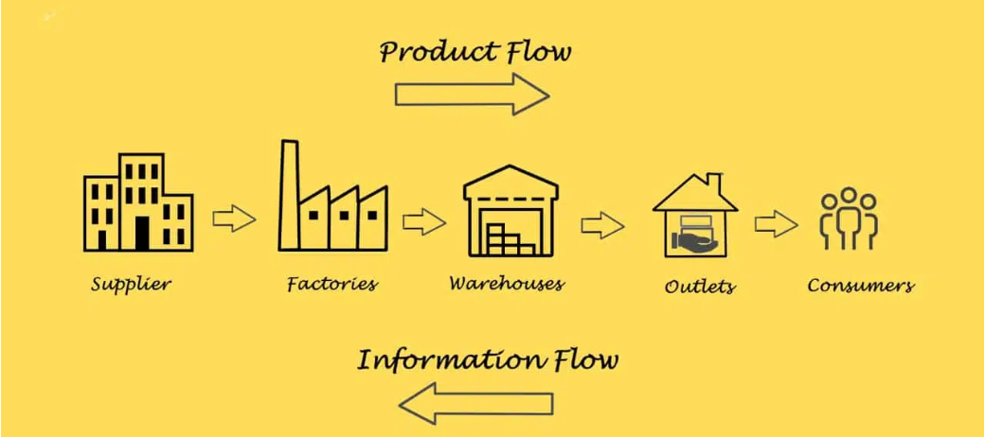
1.What is Supply Chain Design?
1.1 Introduction Supply chain design and management involves structuring and overseeing the flow of goods, information, and finances as products move from suppliers to manufacturers to wholesalers to retailers to consumers.
1.2 Business Aspect: Supply chain design in business aligns customer needs with supplier capabilities, mitigates risks, enhances competitiveness, and optimizes operations for added value, cost efficiency, growth, and adaptability to market changes.

Slide 3
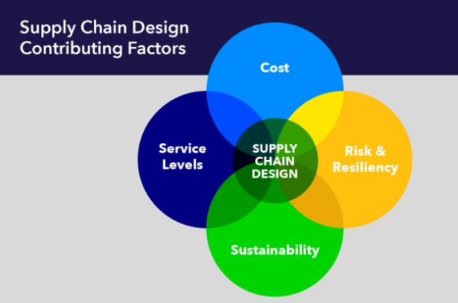
1.3 Supply Chain Network Design
Supply chain network design is like the architectural blueprint of your business’s logistics operations.
Get it right, and you can streamline your operations, save money, and improve customer satisfaction.
Get it wrong, and you may end up with inefficiencies, delays, and higher costs.
Service levels encompass various aspects of delivering products or services, including on-time delivery, order accuracy, lead times, and responsiveness to customer demands.
sustainability refers to minimizing the carbon footprint, reducing waste, and considering social responsibility in the design and operation of supply chains.
Reliability ensures the consistent and efficient flow of goods and services.

Slide 4
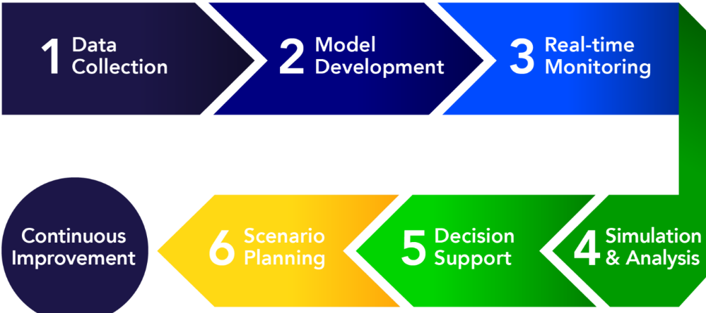
1.4 Digital Twin
Data is the key
Data Driven Supply Chain Network Design, In this approach, decisions regarding the configuration and management of the supply chain are guided by the analysis of vast and real-time data sets.
Digital Twin
-virtual representation of a physical object, system, or process.
-highly detailed and dynamic digital model that mimics the behavior and characteristics of its real-world counterpart.
-Implementation is as follows :

Slide 5
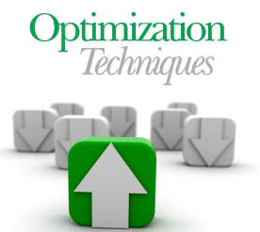
2.Importance of Optimization in Supply Chain Design
Optimization : The act of obtaining the best result under the given circumstances.
Optimization techniques play a critical role in improving supply chain management by enhancing efficiency, reducing costs, and improving overall performance.
Optimization plays a crucial role in supply chain design and management, offering several benefits:
Cost Reduction: Identifying the most efficient routes, inventory levels, and production schedules to minimize costs.
Efficiency Improvement: Streamlining operations to reduce waste, improve resource utilization, and enhance productivity.
Customer Satisfaction: Ensuring timely delivery and high service levels by optimizing logistics and distribution.
Risk Management: Anticipating and mitigating potential disruptions through robust planning and adaptive strategies.
Sustainability: Reducing environmental impact by optimizing resource usage and transportation.

Slide 6
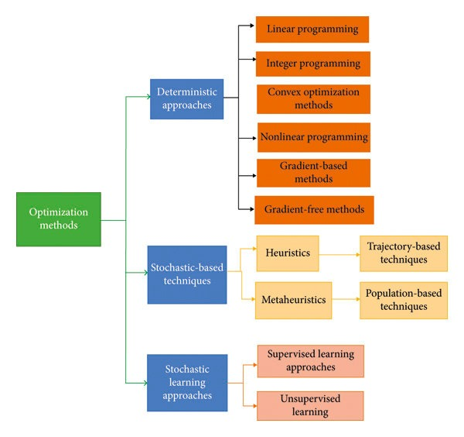
3.Types of Optimization Techniques
3.1 Optimization Techniques

Slide 7
3.2 Deterministic Optimization
Deterministic optimization focuses on finding the best solution under specific, known conditions without considering uncertainty or randomness.
Algorithms:
Linear Programming (LP): LP models optimize linear objective functions subject to linear constraints. It's used for capacity planning, production scheduling, and transportation optimization.
Integer Programming (IP): IP extends LP by including integer variables, useful for problems with discrete decisions like facility location and production planning with fixed setup costs.
Dynamic Programming (DP): DP breaks down complex problems into simpler sub-problems and recursively finds optimal solutions. It's used for inventory management and resource allocation over time.

Slide 8
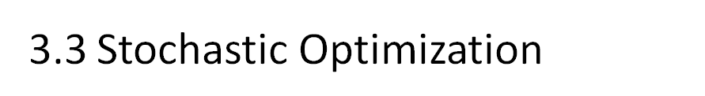
Stochastic optimization considers uncertain variables and probabilistic outcomes in decision-making processes.
Algorithms :
Stochastic Programming: Incorporates probabilistic constraints or objectives to account for uncertainty in supply chain parameters such as demand variability or lead time variability.
Monte Carlo Simulation: Uses random sampling to simulate uncertain variables and estimate the distribution of possible outcomes. It's used for risk analysis and scenario planning in supply chain networks.

Slide 9

Robust optimization aims to find solutions that perform well across a range of possible scenarios, typically by considering the worst-case scenario or variability within a defined uncertainty set.
Algorithms :
Robust Optimization with Adjustable Variables: Involves decision variables that can be adjusted based on the realization of uncertainties.
Robust Linear Programming (RLP): An extension of linear programming that deals with uncertainty in the coefficients of the constraints.
Robust Integer Programming (RIP):A robust optimization approach where some or all decision variables are required to be integers.

Slide 10
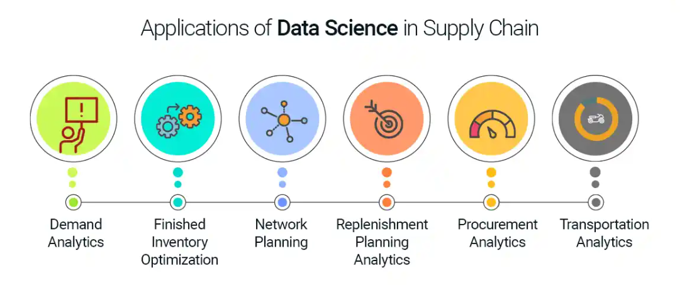
4.Application Areas in Supply Chain Design
Inventory Management: Optimizing stock levels to balance costs and service levels.
Transportation and Logistics: Optimizing routing and scheduling to reduce costs and improve delivery times.
Production Planning: Balancing production schedules with demand forecasts to minimize costs and delays.
Warehouse Location and Design: Determining optimal locations and layouts for storage facilities to minimize costs and maximize efficiency.
Demand Forecasting: Using predictive analytics to optimize inventory and production planning.
Supplier Selection and Management: Optimizing the selection and management of suppliers to ensure quality and cost-effectiveness.

Slide 11
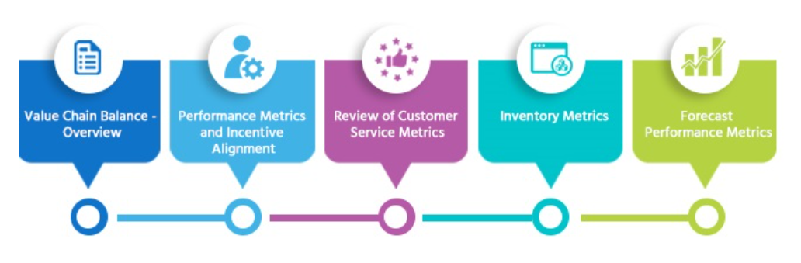
5.Supply Chain KPI Metrics
1. Efficiency Metrics
These metrics measure how well resources are utilized to achieve the desired outcomes, focusing on minimizing costs and waste.
Inventory Turnover
Order Fulfillment Cycle Time
Transportation Cost per Unit
Warehouse Utilization

Slide 12
2. Effectiveness Metrics
These metrics focus on the outcome quality and how well the supply chain meets customer expectations.
On-Time Delivery Rate
Perfect Order Rate
Fill Rate
Customer Order Cycle Time
3. Sustainability Metrics
These metrics measure the environmental and social impact of the supply chain operations.
Carbon Footprint
Energy Consumption
Waste Reduction Rate
Supplier Sustainability Score

